Slide 2
Connecting and Securing Services for Hybrid and Multi Cloud Kubernetes
Rania Mohamed

Slide 3
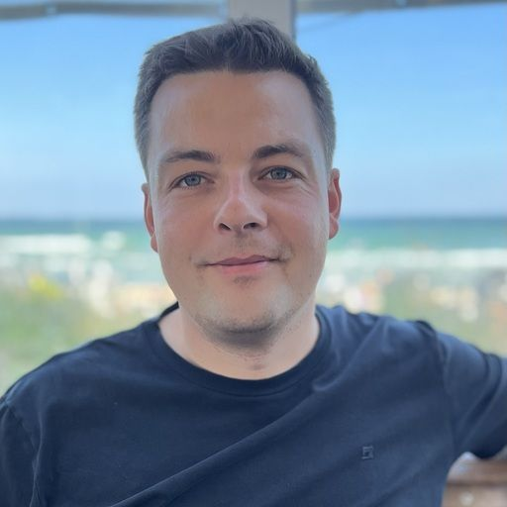

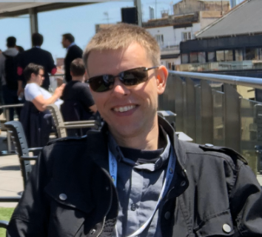
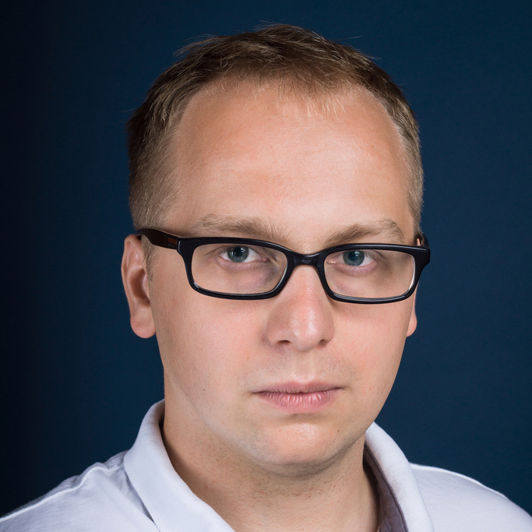
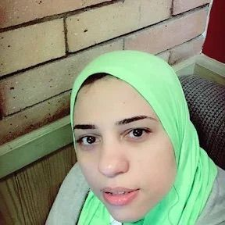
Meet the Panelist
Christian Huening
Ricardo Rocha
Roland Kool
Piotr Szczesniak
Rania Mohamed
Lead Service Manager
Cloud, BWI
Computing Engineer,
CERN
System Engineer,
bol.com
Tech Lead/Manager,
Google
Solution Architect,
Google

Slide 4

Thank You,
Your feedback matters :) !
Please scan the QR Code above
to leave feedback on this session

